Slide 1
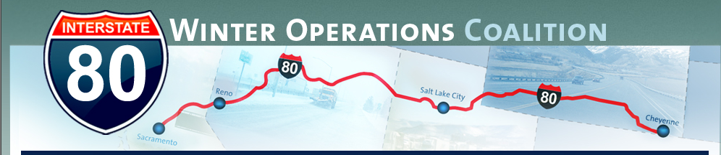
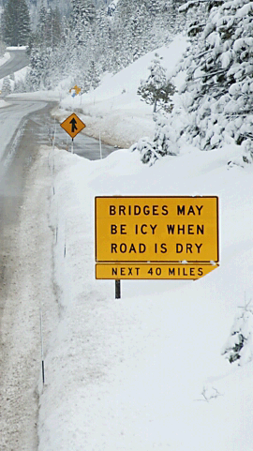
Bill Hoffman
I-80 Corridor Coalition
FALL WORKSHOP
October 27th, 2010

Slide 2
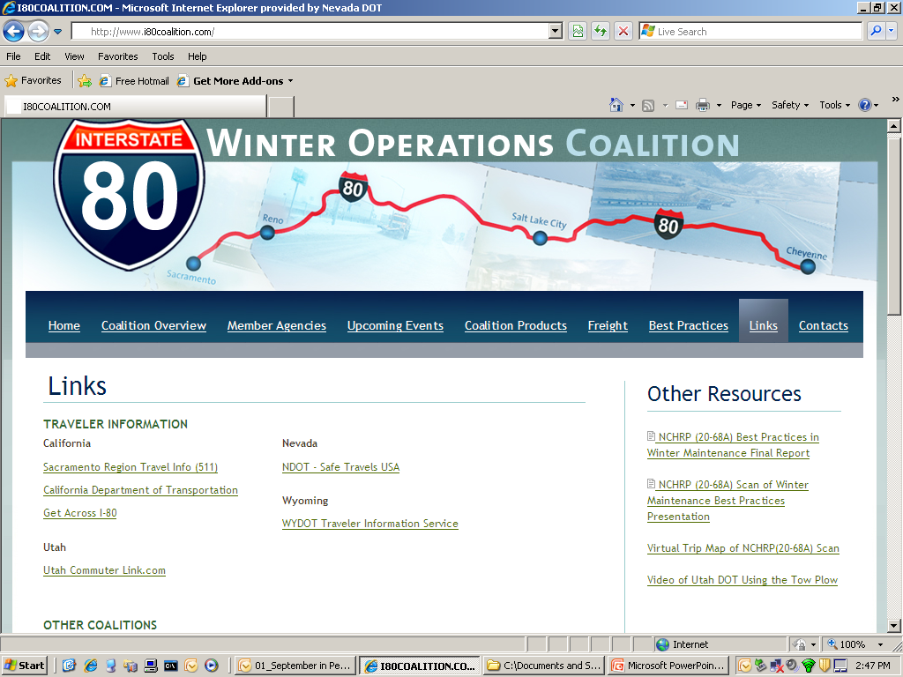

Slide 3
Important Websites
www.aurora-program.org/knowledgebase
www.dot.state.mn.us/maintenance/training.html
www.clearroads.org

Slide 4
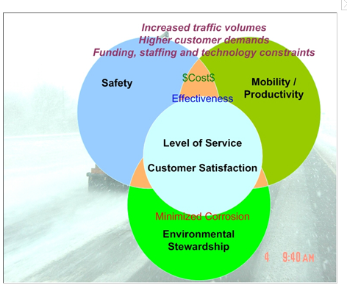
SUSTAINABILITY
Courtesy - Xianming Shi – Western Transportation Institute

Slide 5
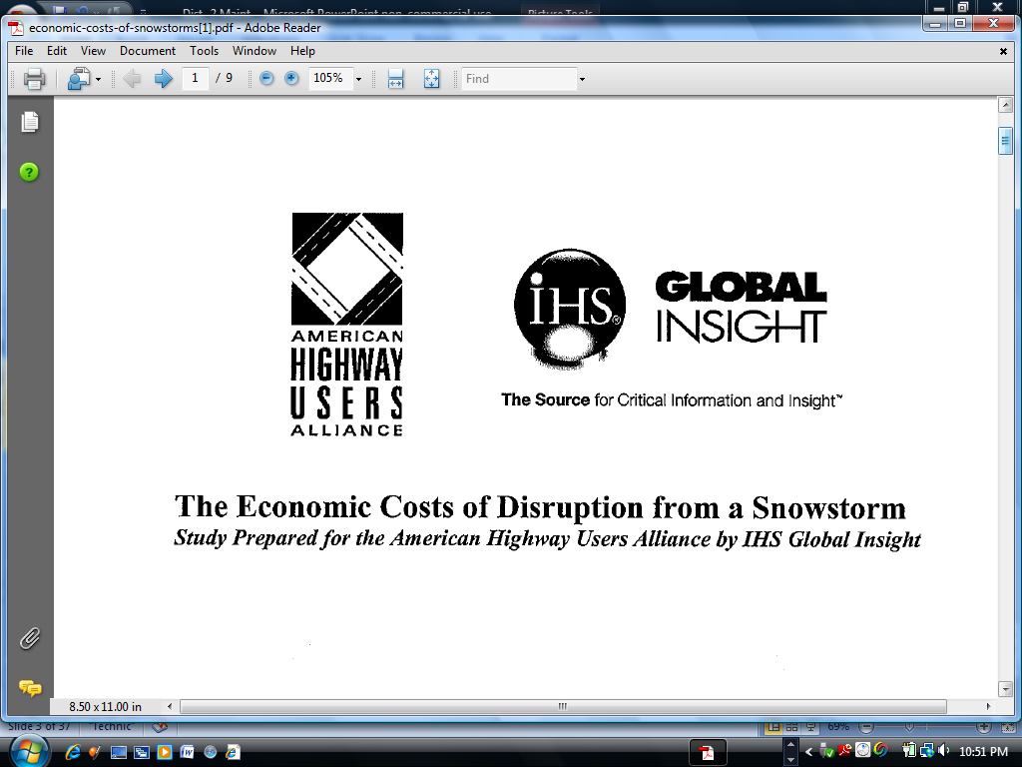
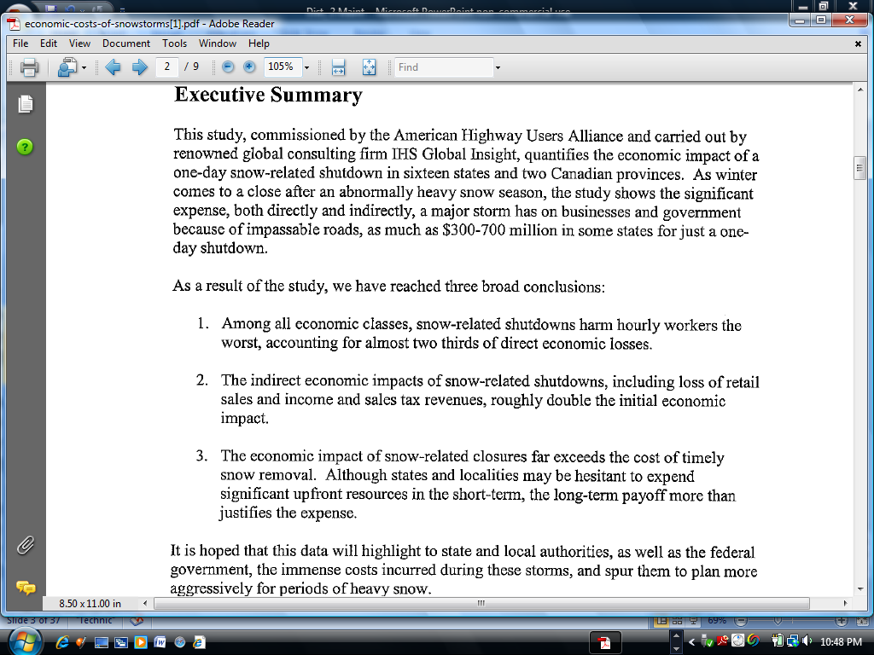
Cost of a One-Day Storm

Slide 6
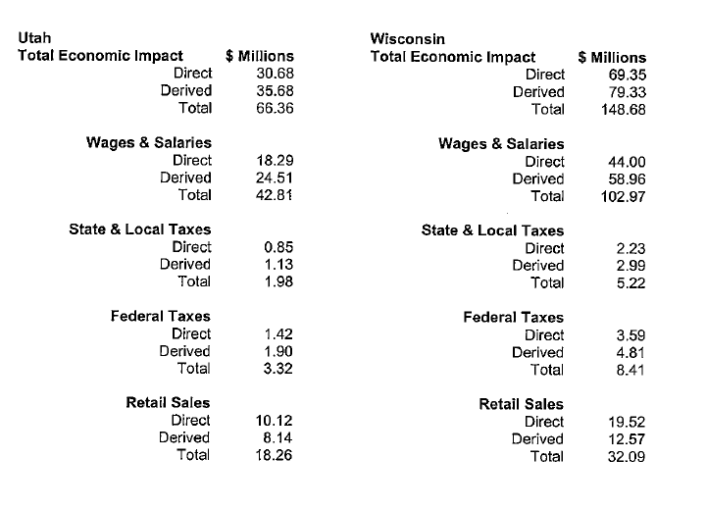
Cost of a One-Day Storm

Slide 7
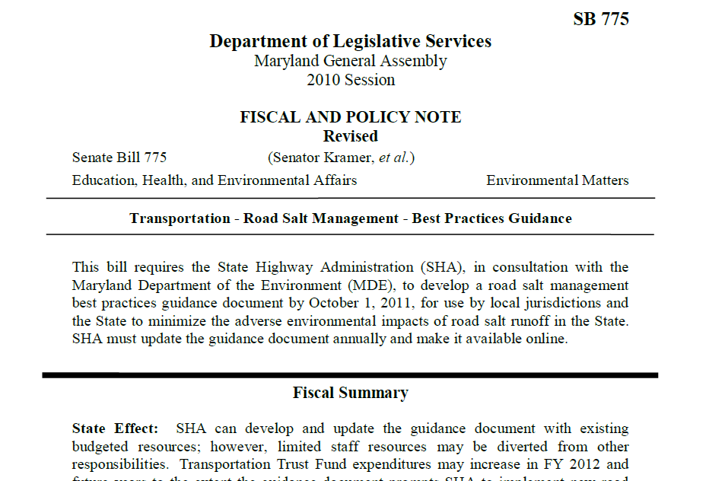

Slide 8
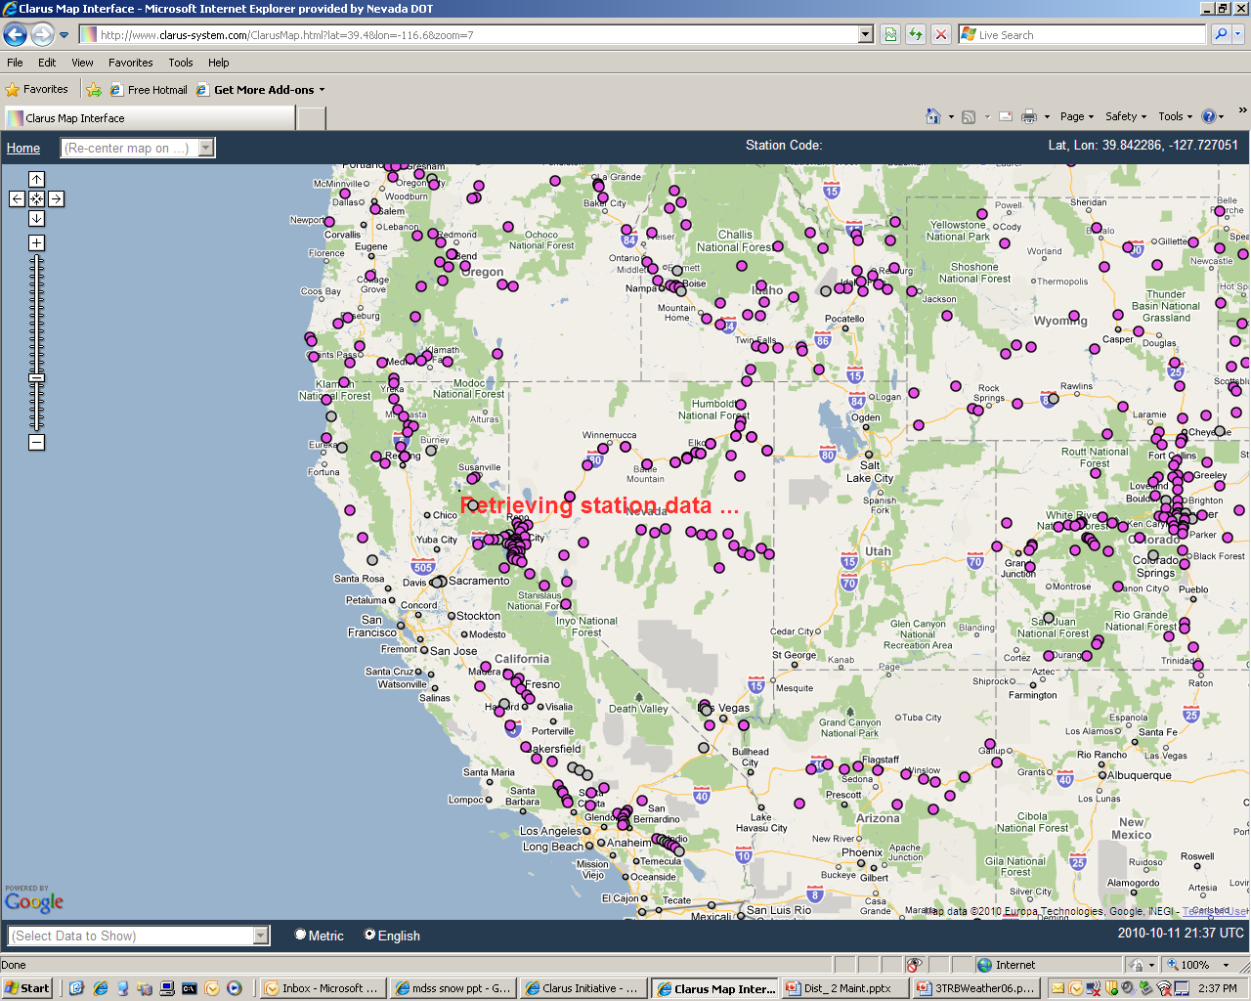

Slide 9
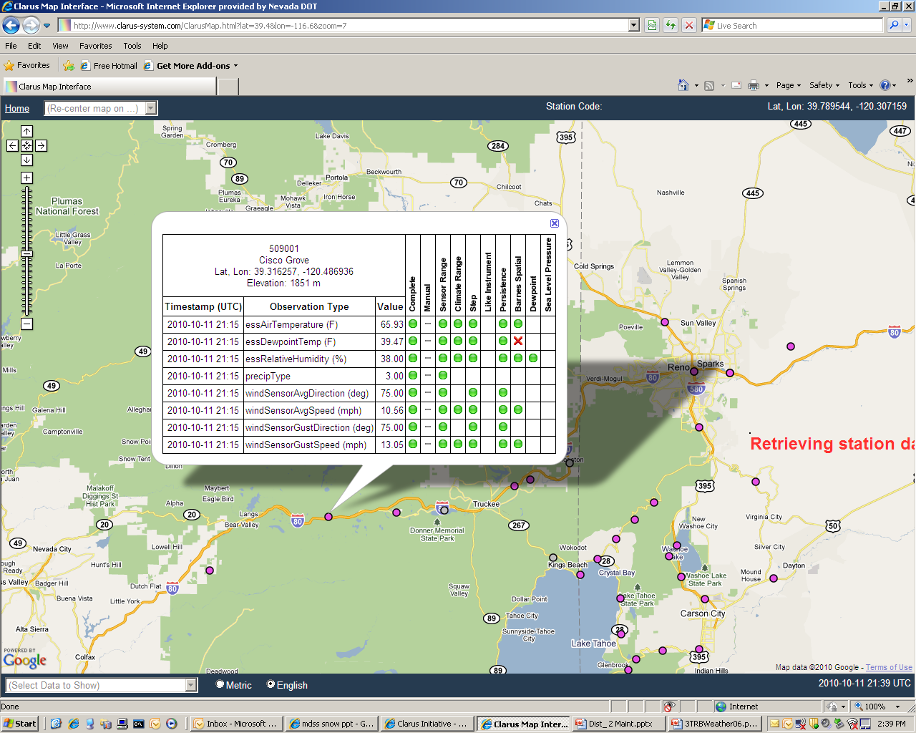

Slide 10

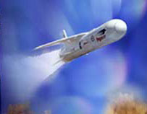
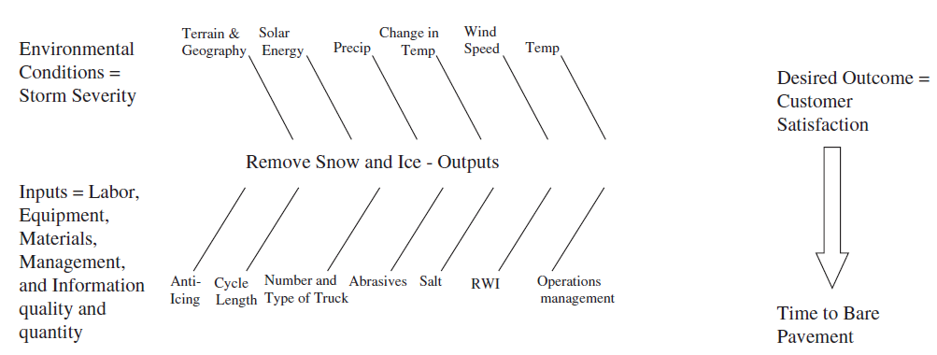
Snow & Ice = Rocket Science ?

Slide 11
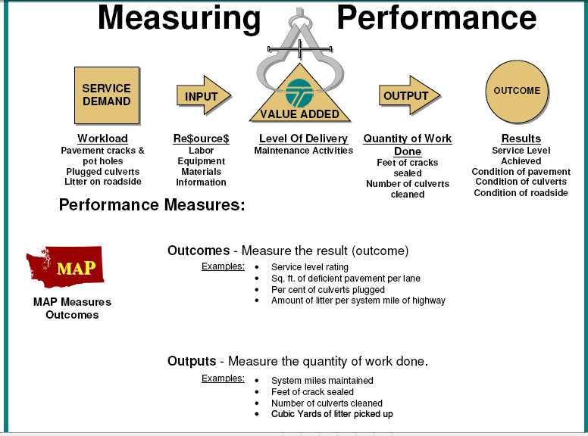

Slide 12
Performance Measures
Inputs – Labor Hours, Equip. Hours, Tons
Outputs – Miles Treated, Miles Plowed
Outcomes – Bare Lanes two hours after storm, A LOS Rating, Traffic Speeds, Reduced Delay
Value to the Customer – No accidents, savings of $X00,000 to the community
Notes:
12

Slide 13
Visual Representation -
Level of Service Ratings
Excellent
Poor

Slide 14
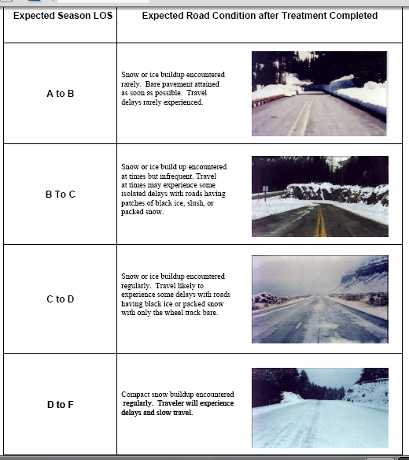

Slide 15
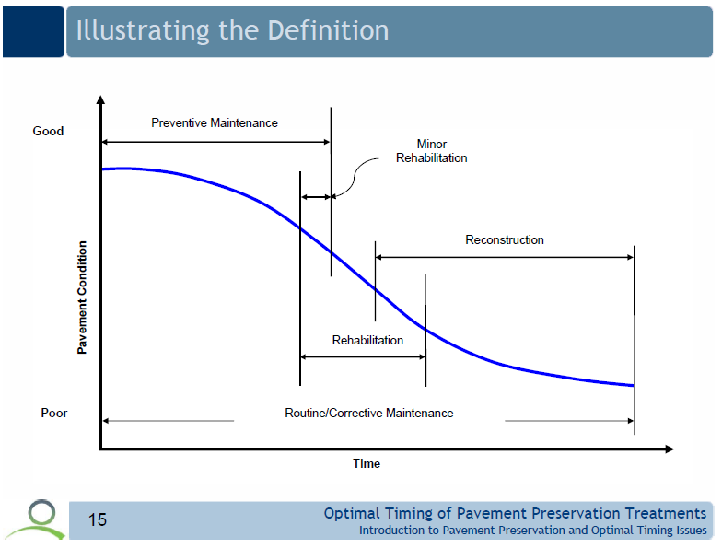
WM Asset Mgmt.
Anti-Icing
Snow Fences
Pre-wetting
Forecasts/
RWIS/MDSS
Motor graders / Dozers
De-icing
Years
Hours

Slide 16
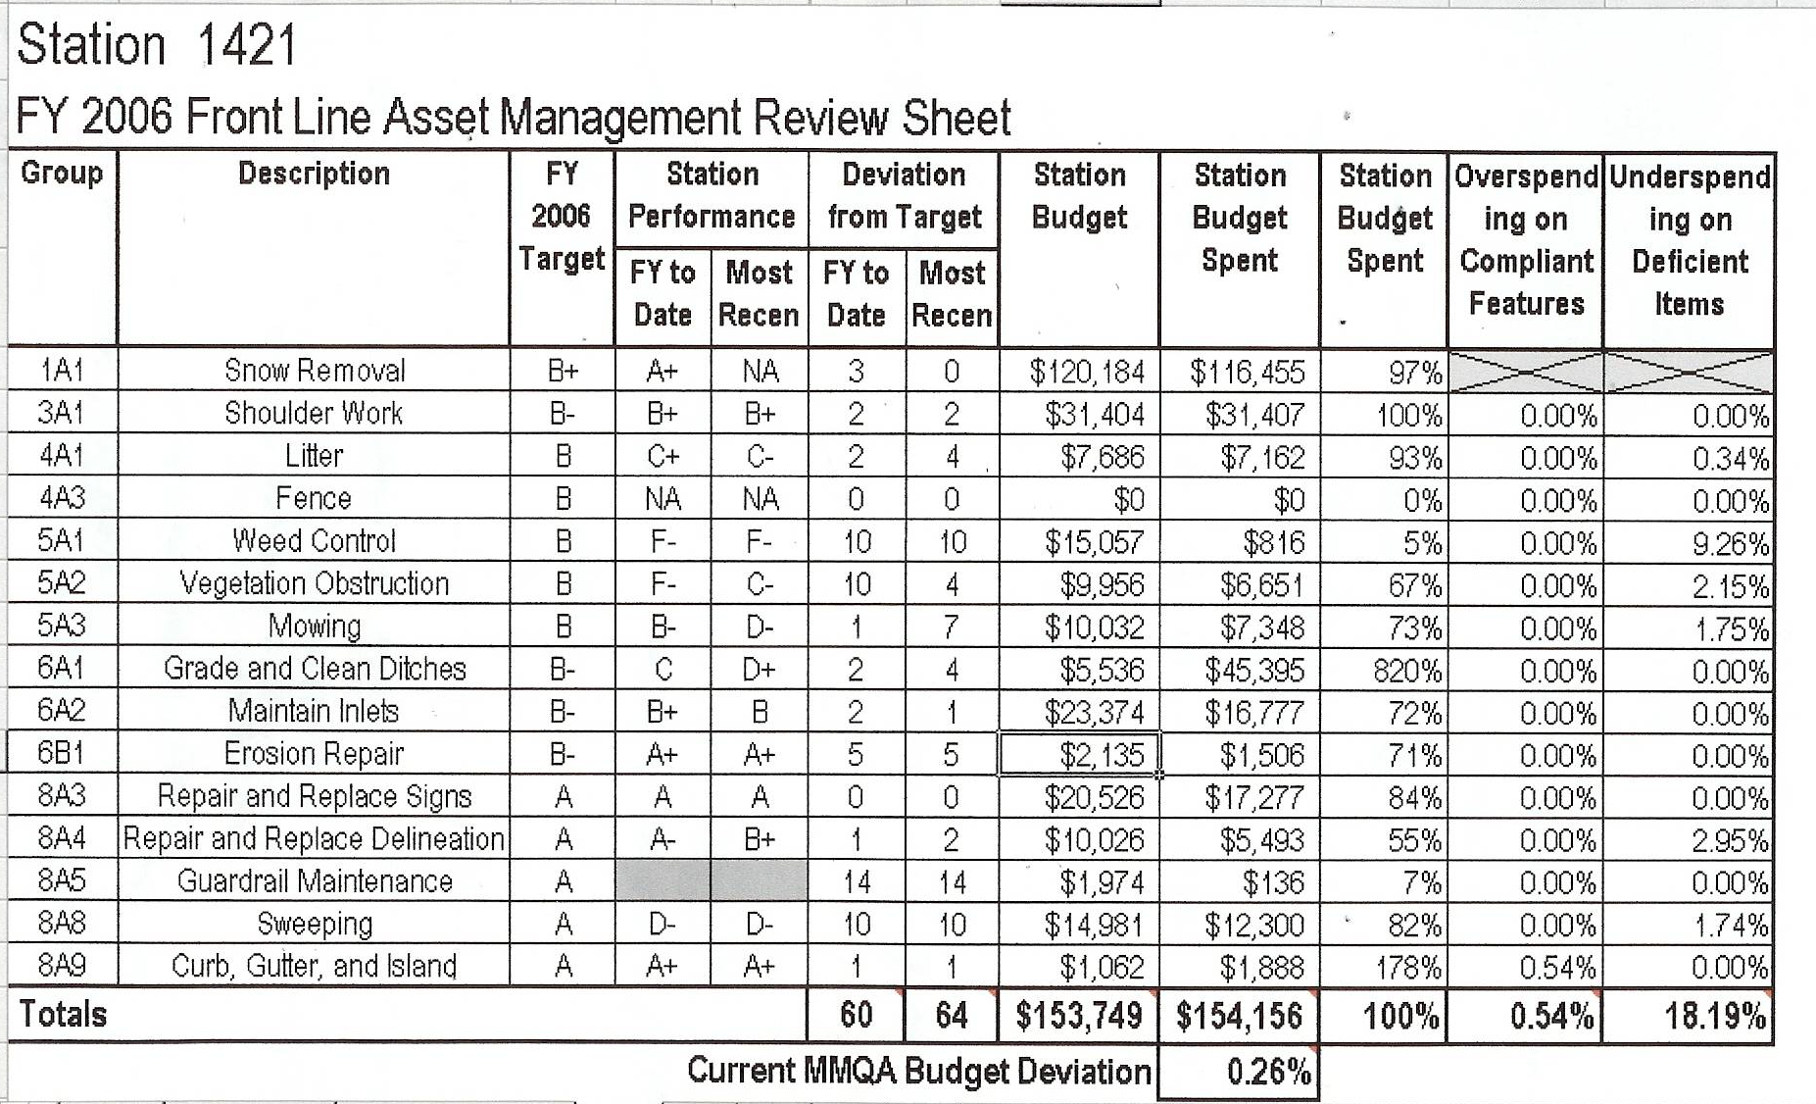
Performance Based Budgeting

Slide 17
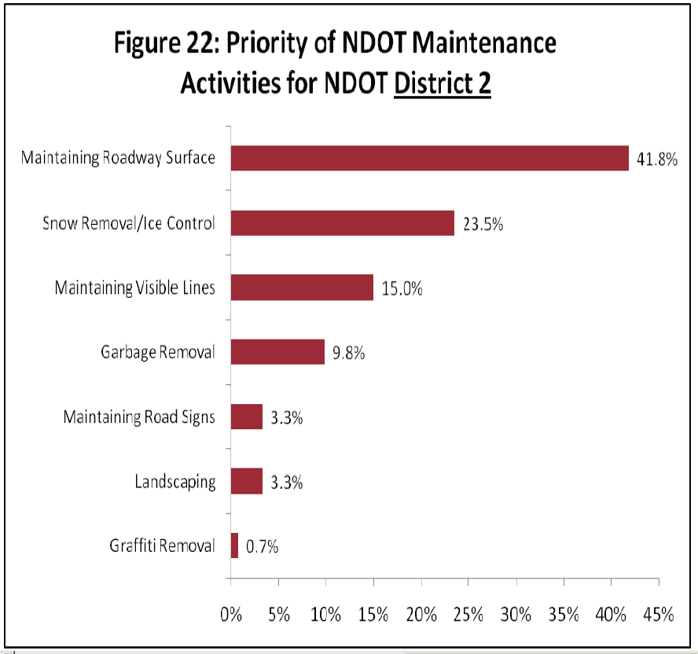
Customer Surveys
Nevada Department of Transportation
2009 Customer Satisfaction Survey

Slide 18
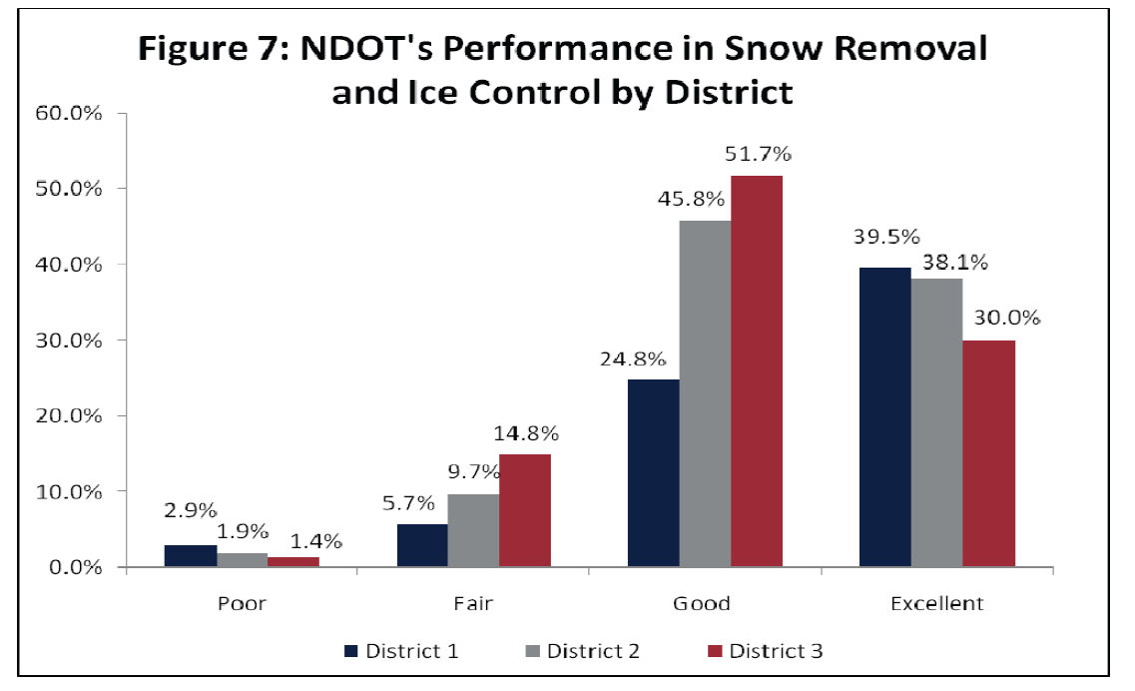
Customer Surveys
Nevada Department of Transportation
2009 Customer Satisfaction Survey

Slide 19
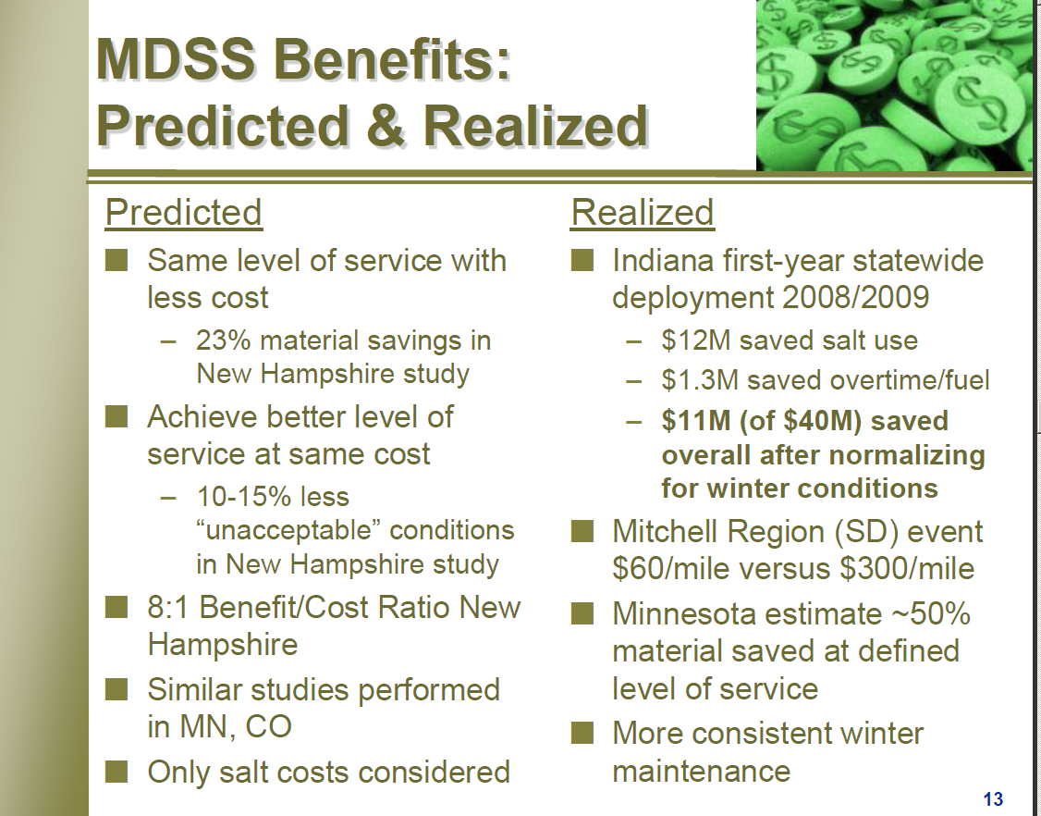

Slide 20
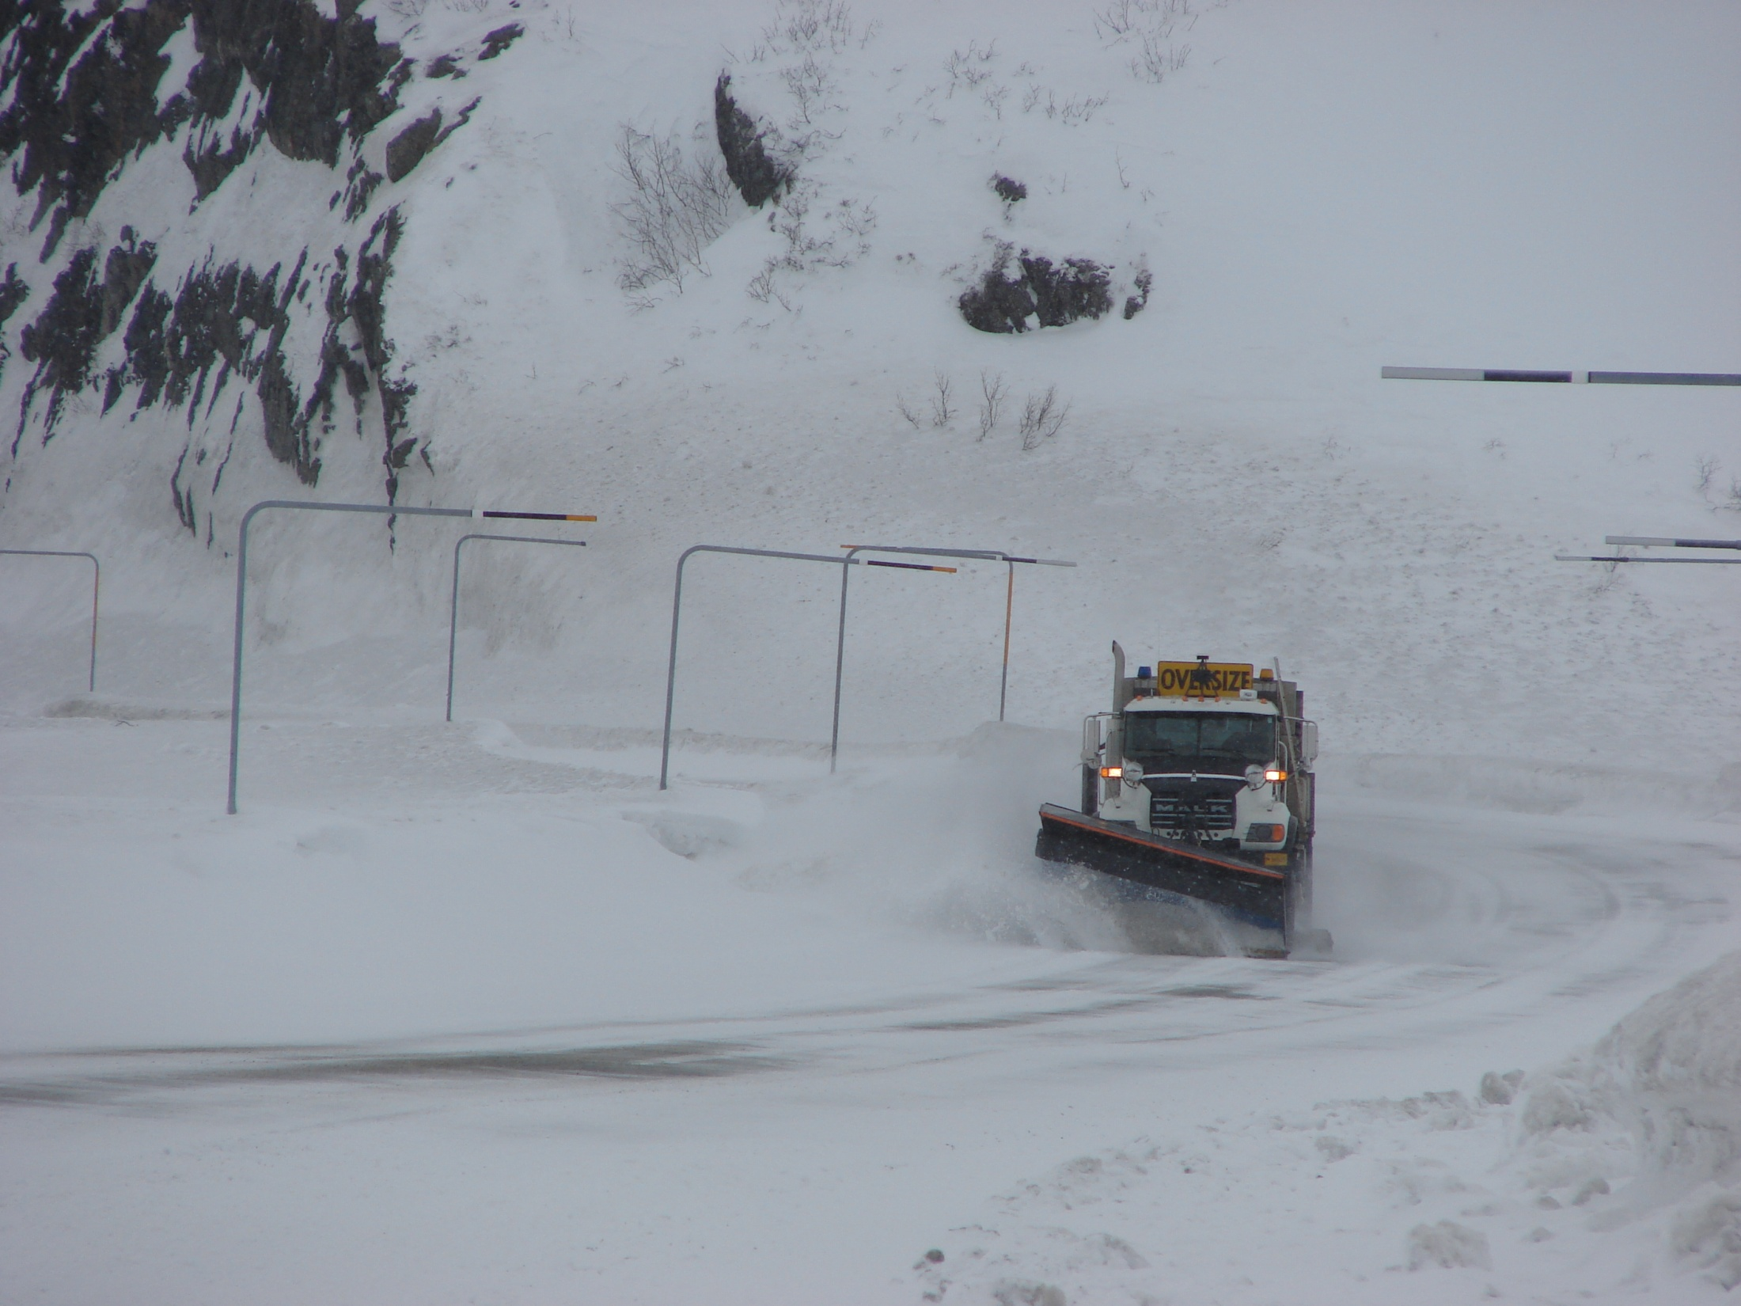
Alaska’s Smart Vehicle System

Slide 21
WTI Survey of Snowplow Operators
992 operators from Idaho, Montana, North Dakota, and Wyoming DOT’s.
  30% indicated that they lost sight of the roadway and shoulders 4-6 times during an average snowstorm.
  83% indicated that if a device existed that would allow for drivers to determine lane position, it would be very useful.
Notes:
Western Transportation Institute. There final report has not been published but they allow us to look at their raw survey results.

Slide 22
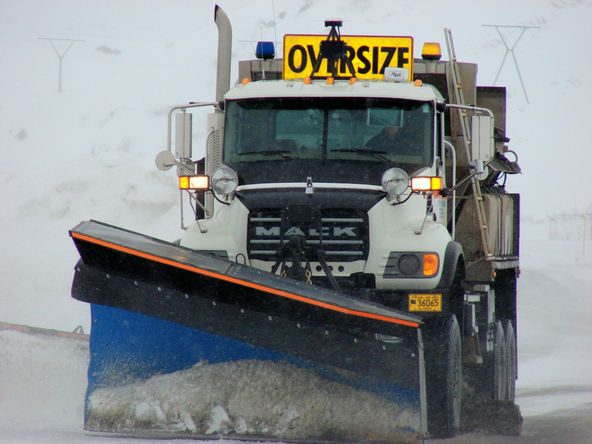
GPS Antenna
VHF DGPS Antenna
Radar Receiver

Slide 23
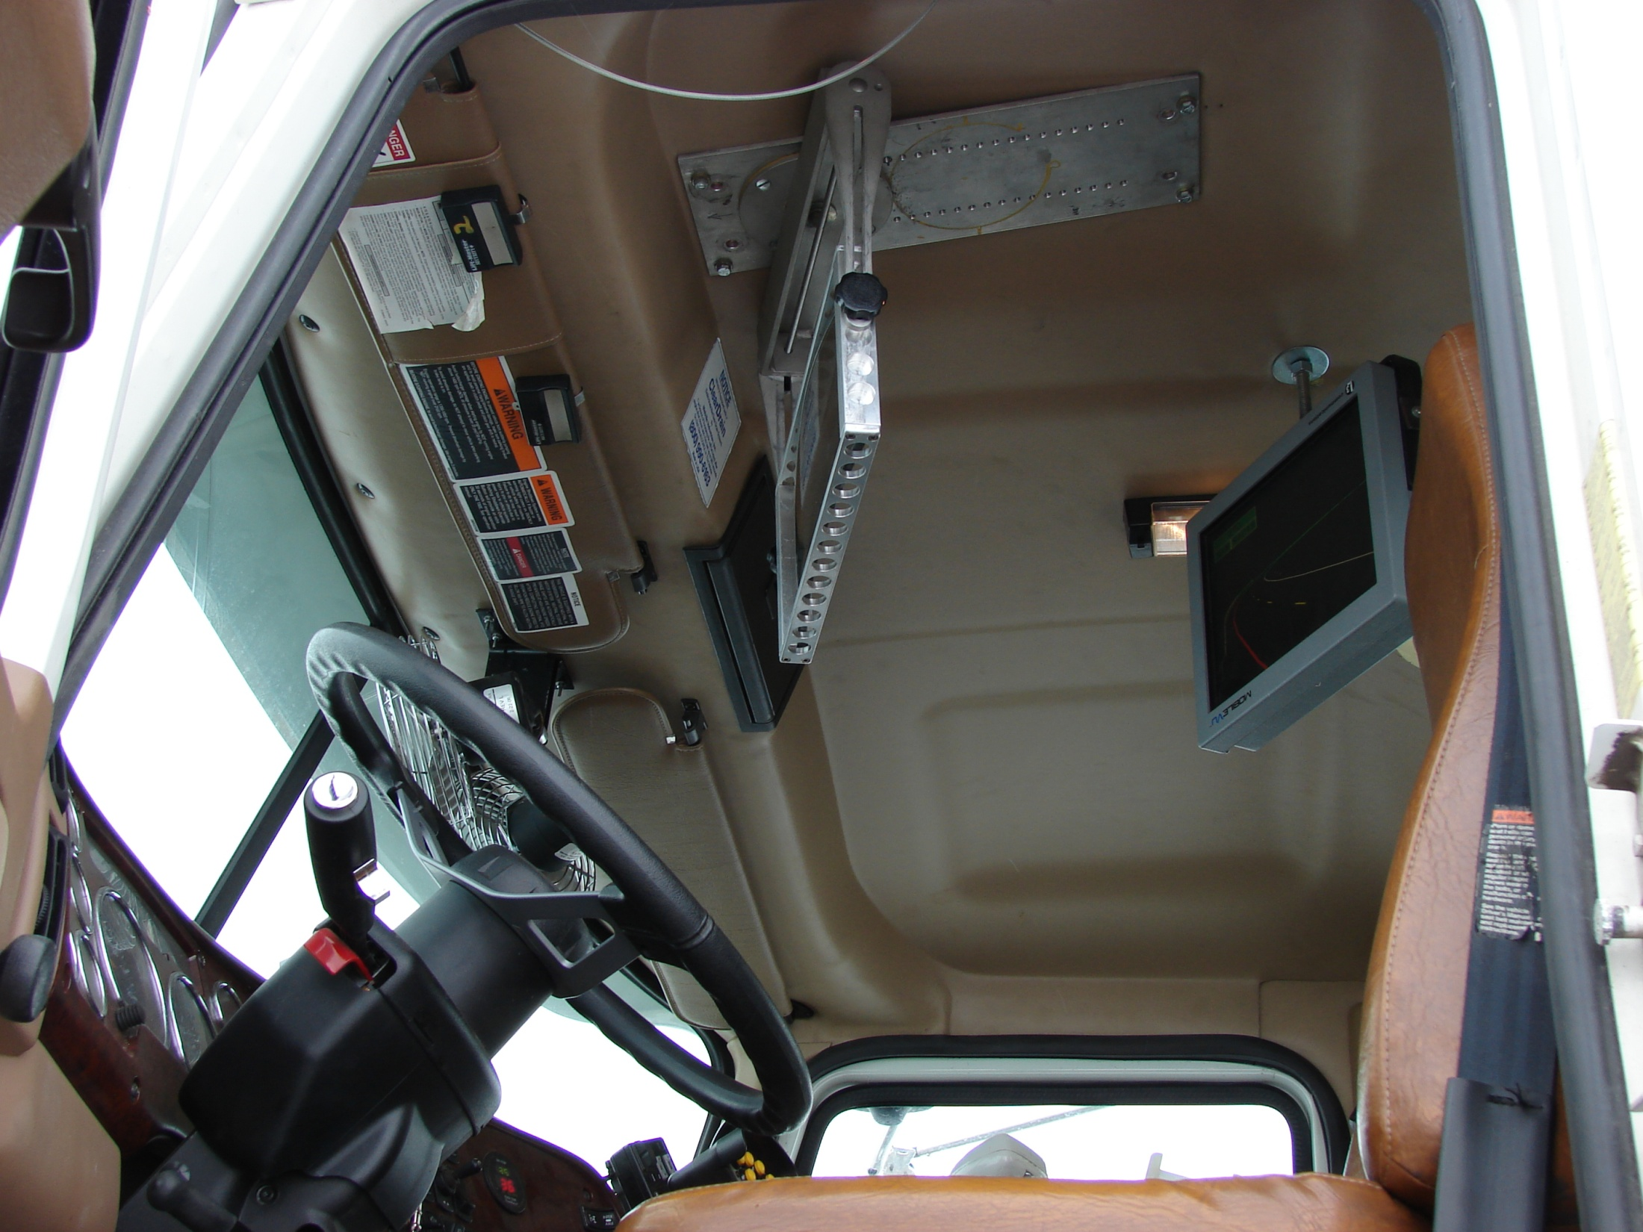

Slide 24
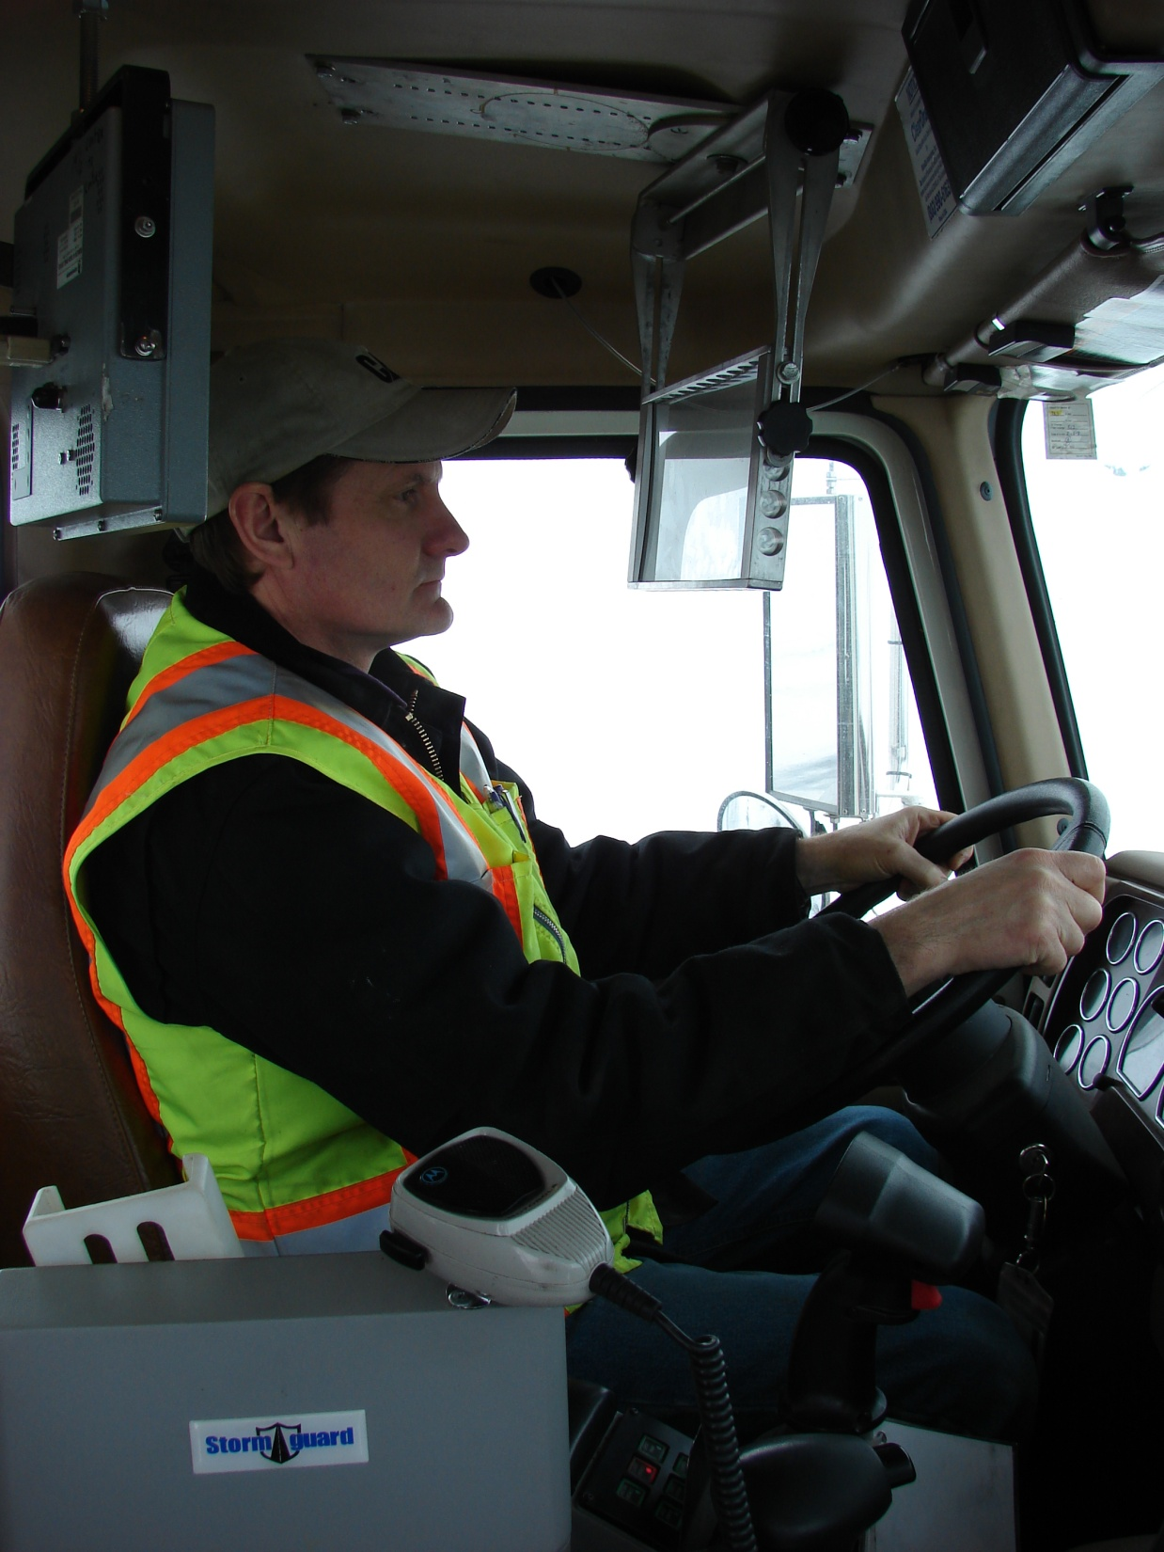
Projector
Head-up-display Image Combiner
Notes:
Head-up-display in DOT snowplow.

Slide 25
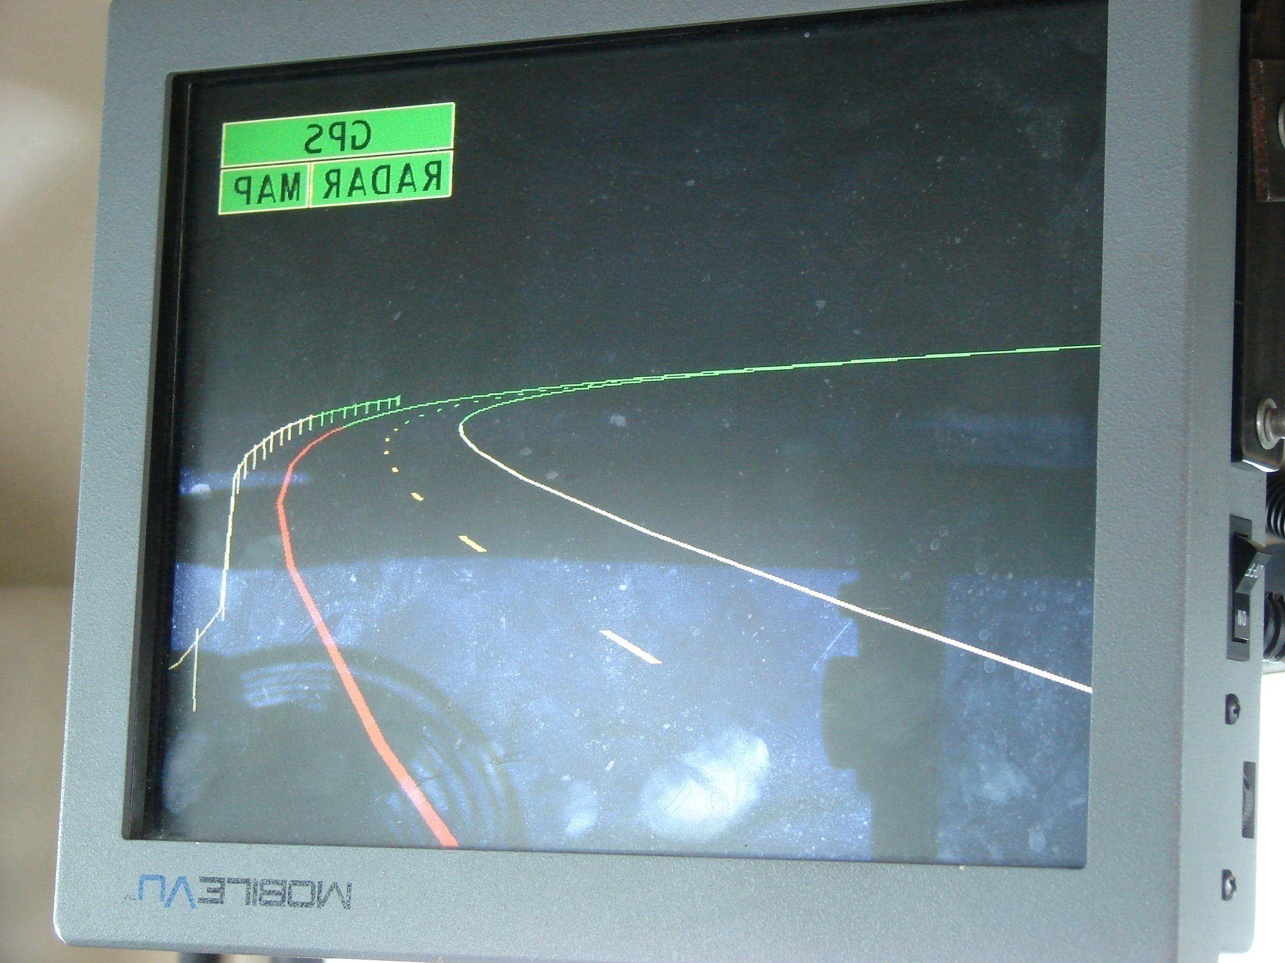
Projector screen with reversed image

Slide 26
Smart Vehicle Project Cost
Cost
Phase I - $244,800.00
Equip 2 trucks
Differential GPS Station
Electronic Map Highway
Cost
Phase II - $550,478.00
Equip 3 trucks
Antenna Tower Foundation and 120’ Tower
Differential GPS Station, Integration of vehicles and stations
Electronic Map Highway

Slide 27
Tow Plow

Slide 28
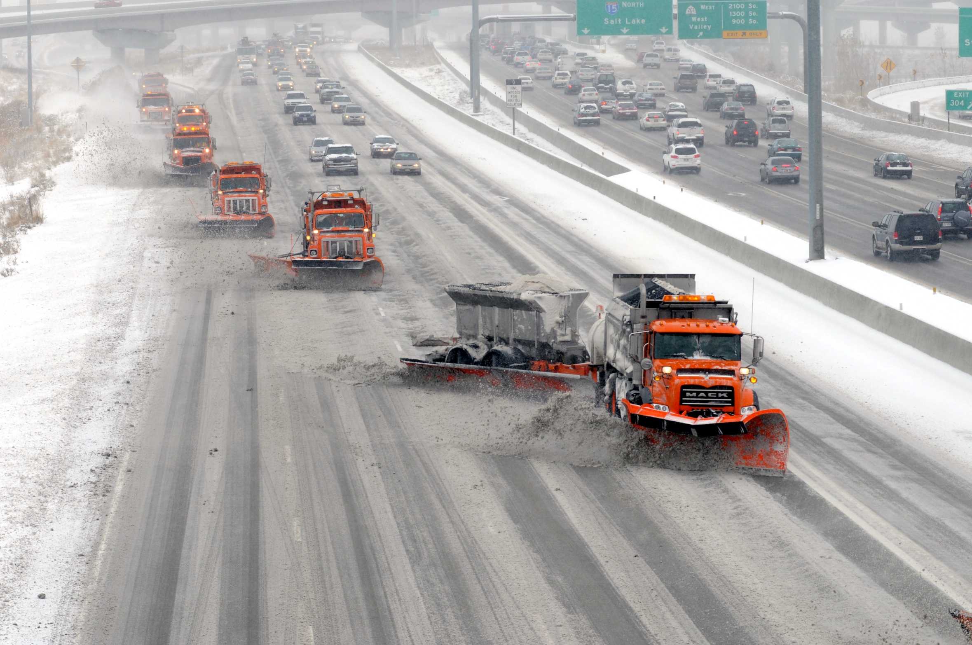
TowPlow Deployment
Notes:
TowPlow I-15 SB Salt Lake City Jan 2010

Slide 29
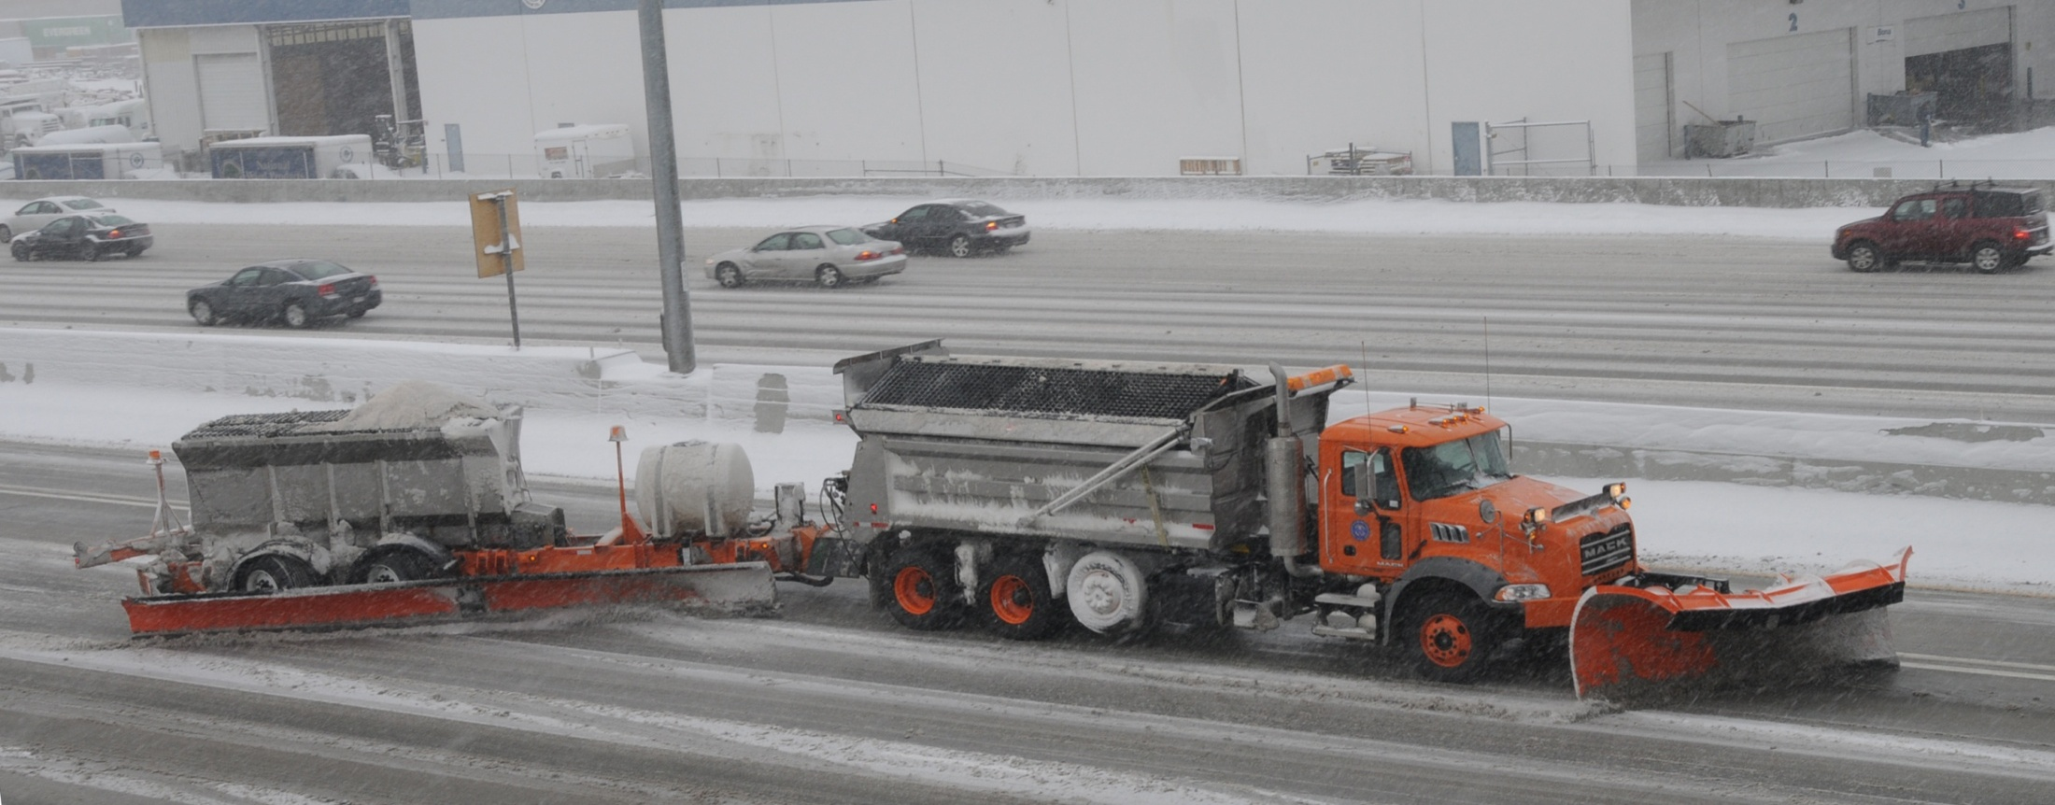
Tow Plow w/spreader and liquid tank
Notes:
I-15 Salt Lake City Jan 2010
We are the only ones with both liquid and solids on our plow
5 cubic yards on plow and 10 on the truck
300 Gal on plow and 250 on truck
Stainless steel bodies

Slide 30
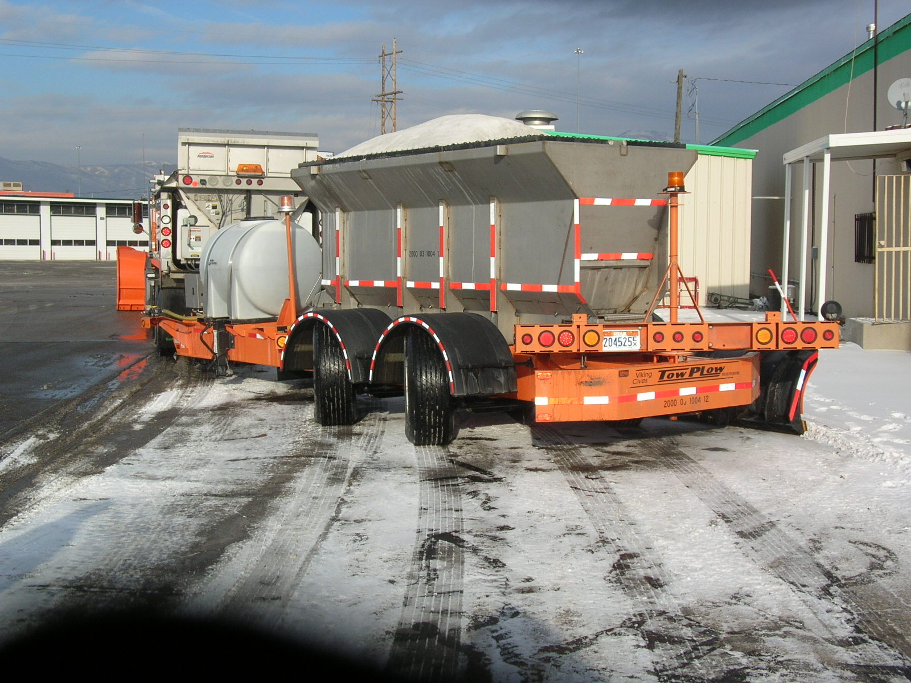
Notes:
TowPlow Rear view showing spreader, liquid tank and steerable axles

Slide 31
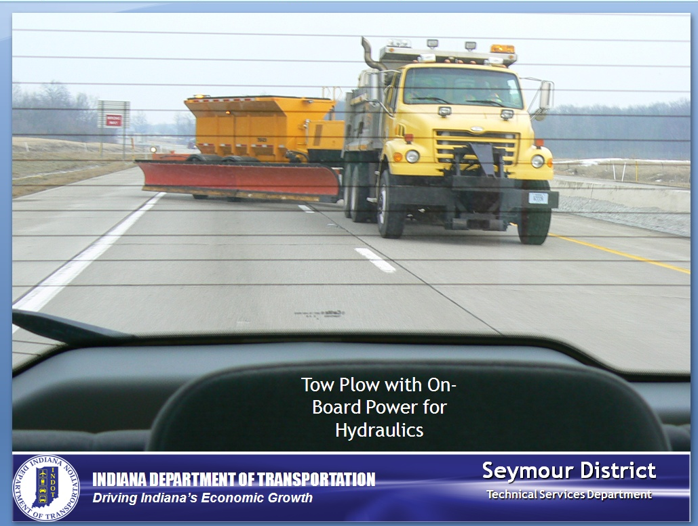

Slide 32
SAFETY / MOBILITY
FORECASTS / CONDITIONS
DOT Decisions
Deployment
Operations
Traveler Decisions
Go/No-GO
WHAT WILL HAPPEN ? WHAT IS HAPPENING? WHAT HAPPENED?

Slide 33
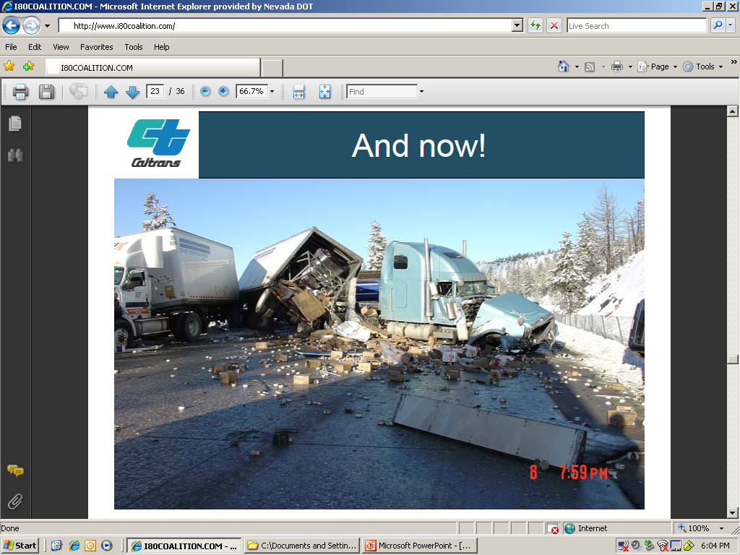
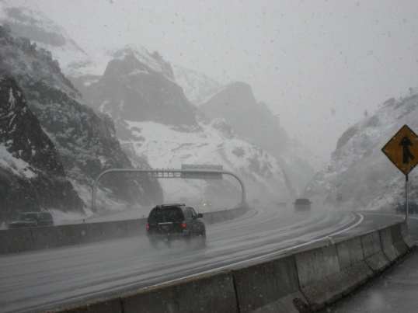
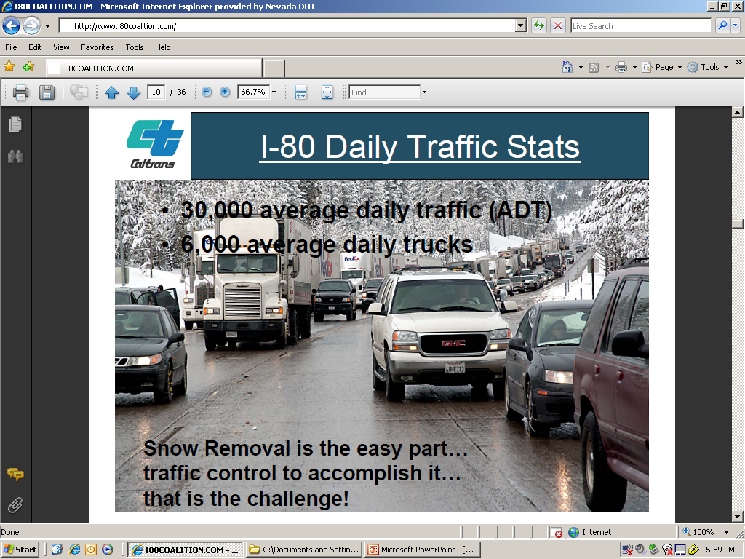
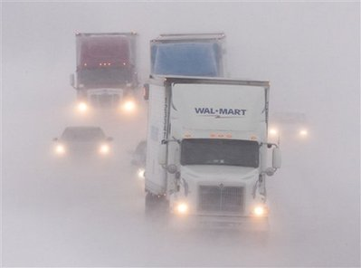
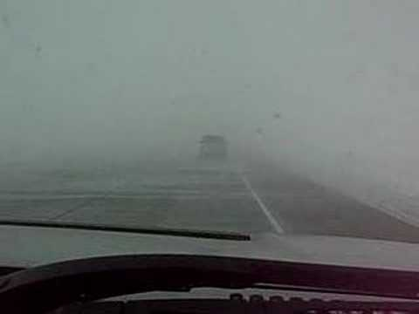
Can We Make a Difference ?
Linking Traffic Management Centers
Focusing on Freight Reliability/Mobility
Maximizing Winter Operations Efficiency

Slide 34
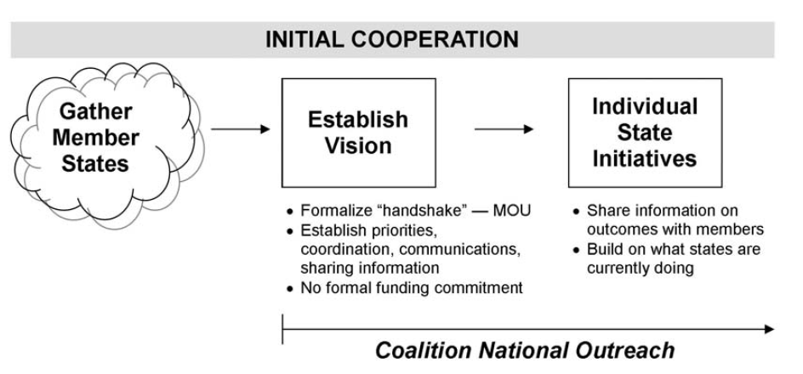
Initial Coalition Structure

Slide 35
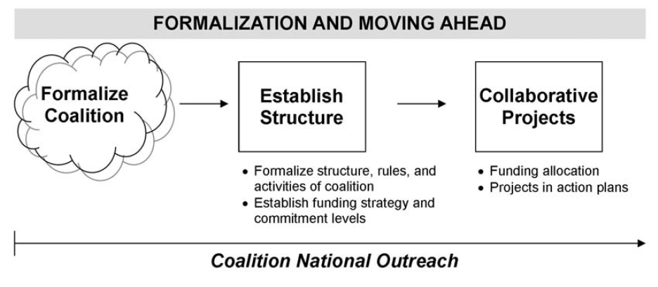
Anticipated Coalition Structure

Slide 36
Coalition Work Completed
Website
Strategic Plan
Action Plan
Aggressive Marketing & PR Efforts
Freight Action Plan
Common 511 Road Descriptors Survey
Winter Maintenance Best Practices
Tiger II Planning Grant Application
IntelliDrive Application

Slide 37
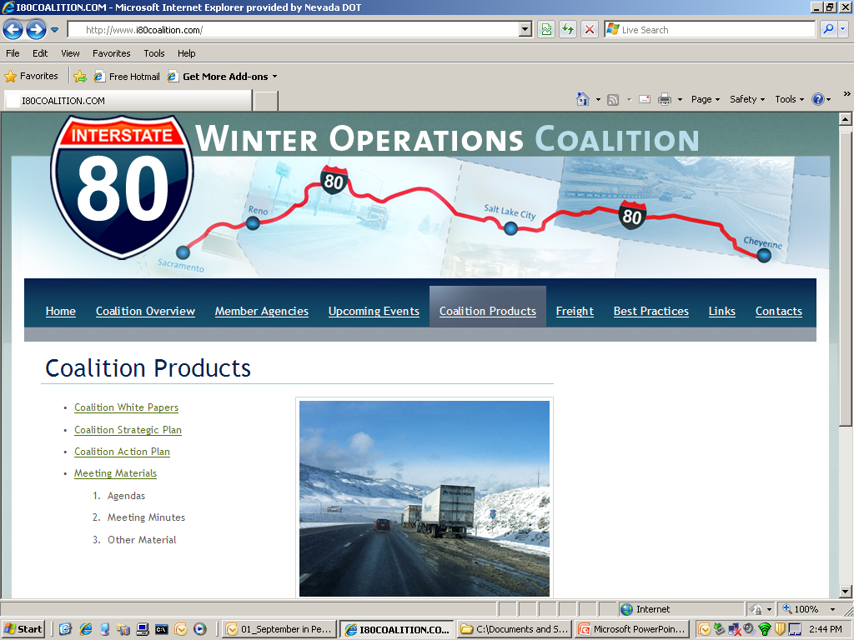

Slide 38
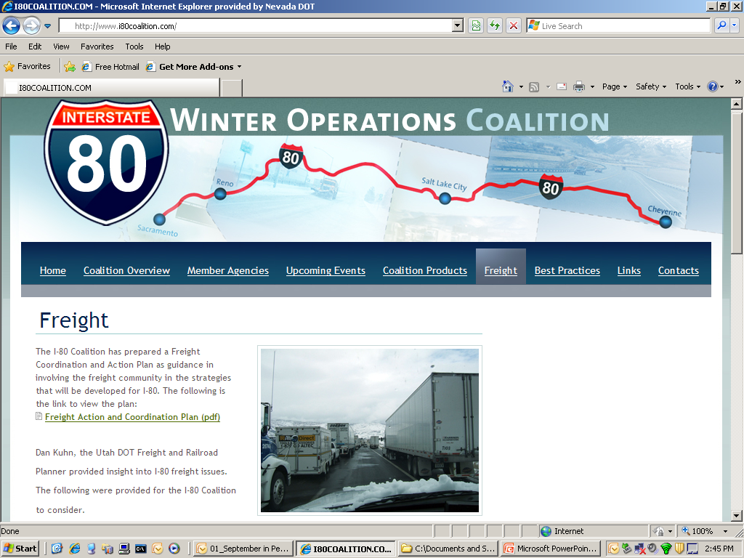

Slide 39
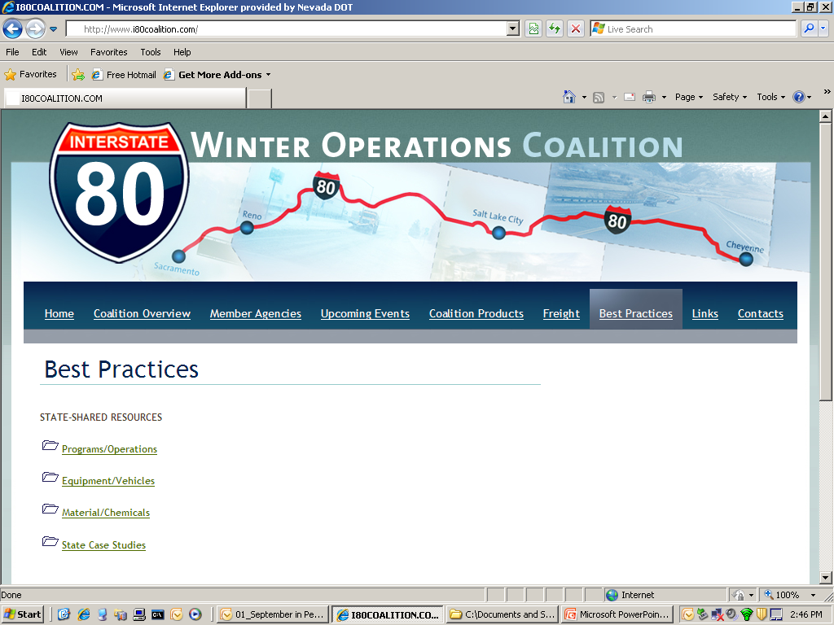

Slide 40
Workshop Charge
Freight Input / Focus Area Guidance
Vendor / Private Sector Input
Best Practices for Interstate Coordination
Best Practices for Winter Maintenance
Strategic Direction for Continued Efforts
ACTION ITEMS for the Upcoming Year

Slide 41
DATA IS KING !!
Automated Vehicle Location Systems
Populate 511 and Maint. Mgmt. Systems
Apps for PDAs
Storm Management Systems

Slide 42
Traffic Operations/TMCs
Traffic management operations during winter conditions.
Regional truck parking coordination during ice and snow events.
TMC integration, coordination, and sharing information between states.
Consistent level of service and weather and road condition descriptors.
Communication between states’ TMCs and maintenance divisions to support traffic activities.
Need to share information on best practices, new technologies, etc. among Coalition members.

Slide 43
Infrastructure/Communications
Adequate coverage of traffic in rural areas and robust coverage in urban areas.
Efficient use of ITS device data and potentially shared use.
Performance Measures
Data collection method and archiving.
Performance measures and monitoring using data to show progress and justify concerns.

Slide 44
Traveler Information
Expand methods to disseminate information efficiently and effectively to travelers.
Consistent content guidelines for traveler information.
Available traveler or road closure information for the corridor across county, state, and district boundaries.
Weather Forecasting
Coordination between states from a weather perspective before a storm hits.
Forecast data inputs to operations/maintenance decisions.
Leverage existing weather programs.
Better weather and database integration for winter operations and management.

Slide 45
Maintenance Support and Equipment
Distribute the impact of trucks and traveler information available to trucks on I-80 across the states.
Operational understanding of neighbor states’ maintenance activities.
Communication between states’ TMCs and maintenance divisions to support maintenance activities.
Freight
Communication with trucking industry and travelers.
Traveler information specific to freight community, and need to have a better understanding of freight-specific needs and issues.
Targeted surveys of corridor users, with emphasis on freight community.

Slide 46
Staffing/Training
Direct communications process established between all states.
Retention of experienced staff and proper training to support operations and maintenance.
Educating the Public and Road Users on our capabilities and the importance of what we’re trying to accomplish.

Slide 47
NCHRP Research Project
A Strategic Plan for Winter Maintenance
National “GRAND” Challenges
Comprehensive Communications Capability
Services & Procedures that Balance Social, Environmental and Economic Factors
Systems Management for a Consistent & Reliable Transportation Network
Deploying New Technology for Winter Maintenance
Lack of Recognition of the Value of Winter Maintenance
Work Force Recruiting & Retention

Slide 48
